Slide 1



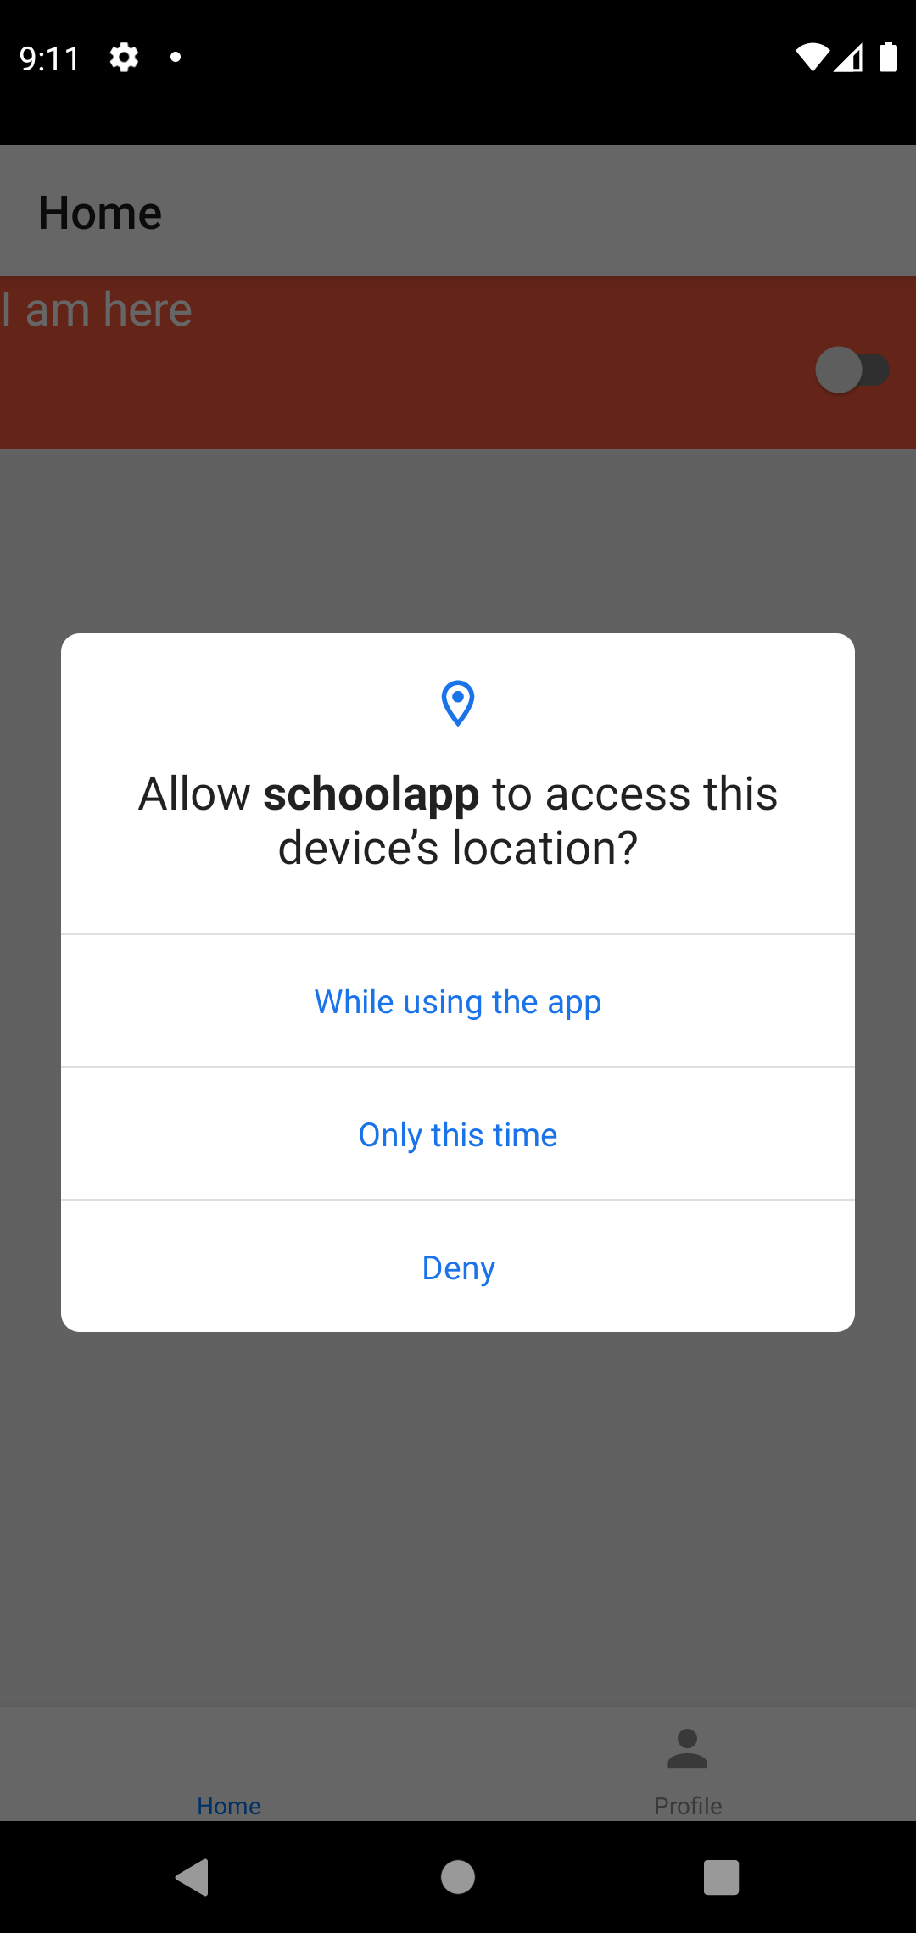
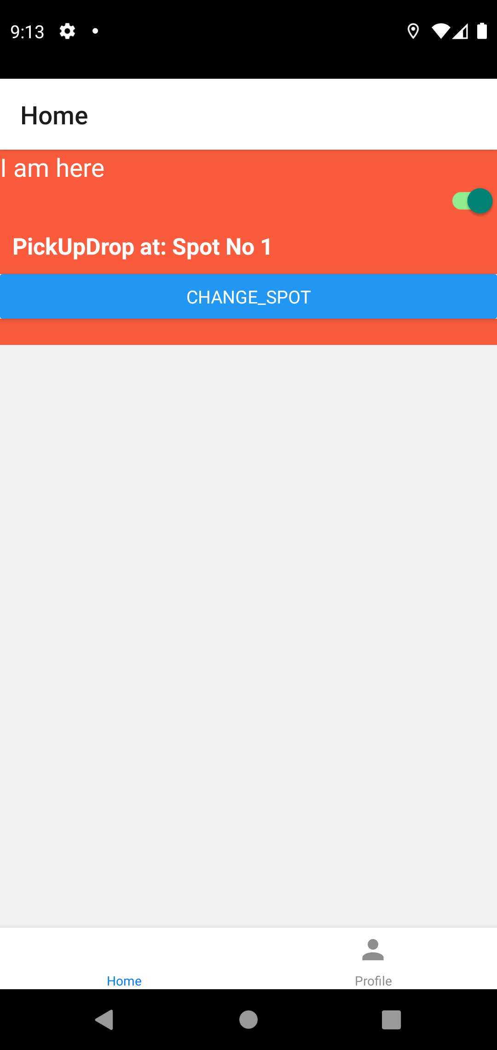
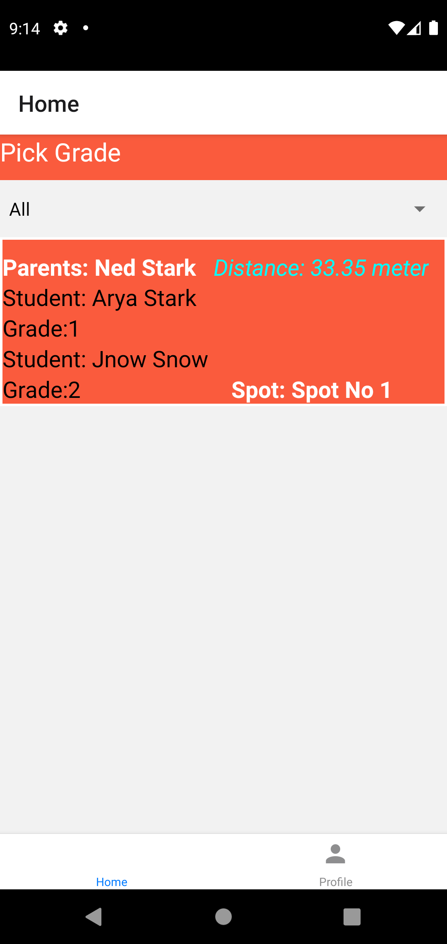
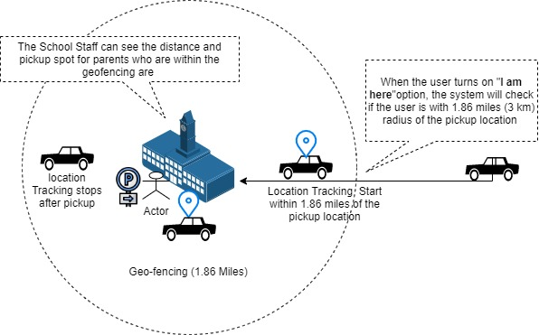
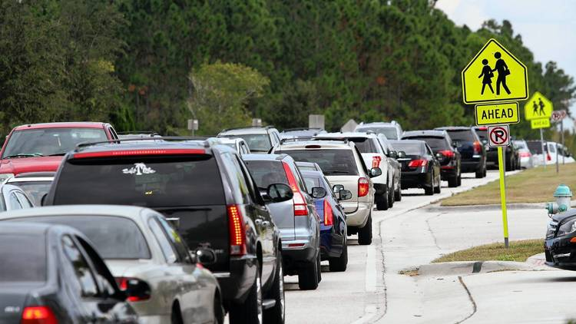
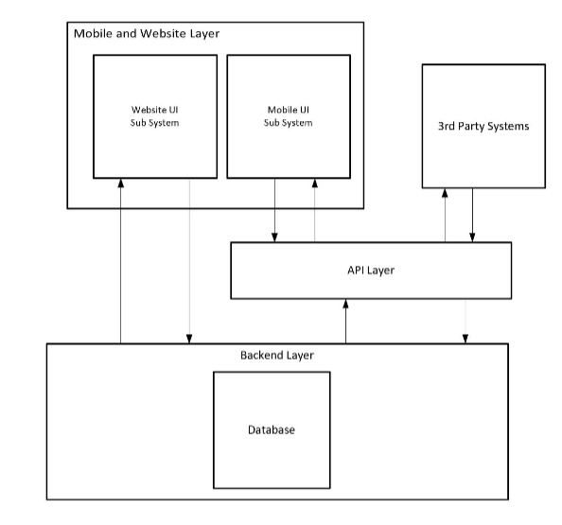
School Pickup And Drop Off App
ARYAL AVINASH, BAJAGAIN UJJWAL, BHANDARI SANTOSH, BACHAGAIN PRABHAT, NOORI MANIZHA, KSHETRI NAVEEN
Sponsor: Dr . Christopher McMurrough
CSE Senior Design Summer 2021
Team: CodeBenders
Executive Summary
Requirements
Prototype
The application "School Pickup and Drop off App" is designed to reduce the long waiting time of parents during picking up their children from school in the peak hour. During the school pick-up time, the traffic around the school becomes congested and sometimes would even block the whole neighborhood which dramatically increases the safety risk of students, parents and School staffs.
The application will track parents’ location and inform teachers and staff when they are near school pickup spot so that they can dismiss students. This will reduce the traditional longer time and make the process safer.
Here is the list of top requirements that are of highest priority for the application:
The Cloud Server and Database should be operational
The school staff/teacher and parents/guardians should have devices which meets the requirements to have the mobile apps installed and running.
The school staff/teacher and parents/guardian's device should have internet connection.
The school administration should maintain accurate record of student and their parents/guardians and provide login credentials.
Detail Design Phase
Background
The traditional method of dismissing students and picking up students is time consuming. Parents end up waiting for a long time and traffic increases around the school pickup zone and sometimes block neighborhood. School Pick Up and Drop Off Application solves the traffic and long waiting time issue in the school pick up area.
Figure 3. Mobile Application screenshot
Conclusions
Sub systems and Data Flow
Mobile UI and Website UI are part of Mobile and Website Layer. Website user interface will directly link with backend using HTTP and Mobile UI will use API layer in the middle while communicating with the backend. API layer's primary objective will be to communicate information between Mobile layer and 3rd party system to backend and vice-versa .Backend Layer is responsible for business logic and database operations.
School Pickup Dropoff App acts as a communication channel between the parents and the school staff so that the overall process of pickup and drop off becomes easier for both parties involved. The goal of this application is to reduce the wait time for both parents and the staff and also mitigate the traffic around the neighborhood . This application is accessible for both the IOS and Android smartphones.
This project helped us gain valuable experience with real world projects to solve real-world problems while attending to budgets, reviews and deadlines. We followed the agile development method where we divided the task among the team members and went through the planning, executing and evaluating phases with constant communication with the sponsor. We also learned to work as a team and have a glimpse of the real-world projects.
Figure 1. School Pickup Traffic Jam Source: Orlando Sentinel
References
Figure 2. A simple data flow diagram
Roth, L. (2018, December 8). Long lines to pick up kids at school peeve parents. OrlandoSentinel.com. https://www.orlandosentinel.com/news/os-xpm-2013-11-09-os-school-pickup-lines-frustration-20131109-story.html.
8/11/2021

